Slide 1
EEG Signal Analysis Project Update
Group A25

Slide 2
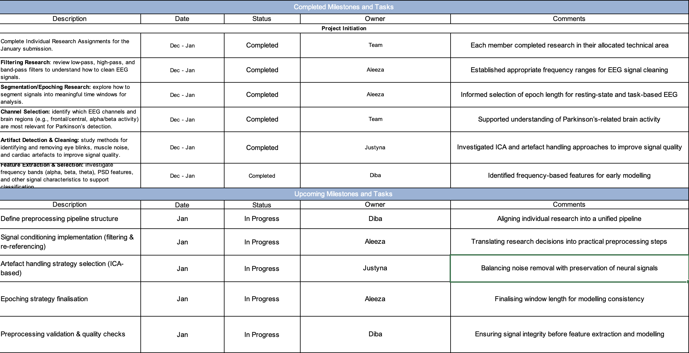
Status Report

Slide 3
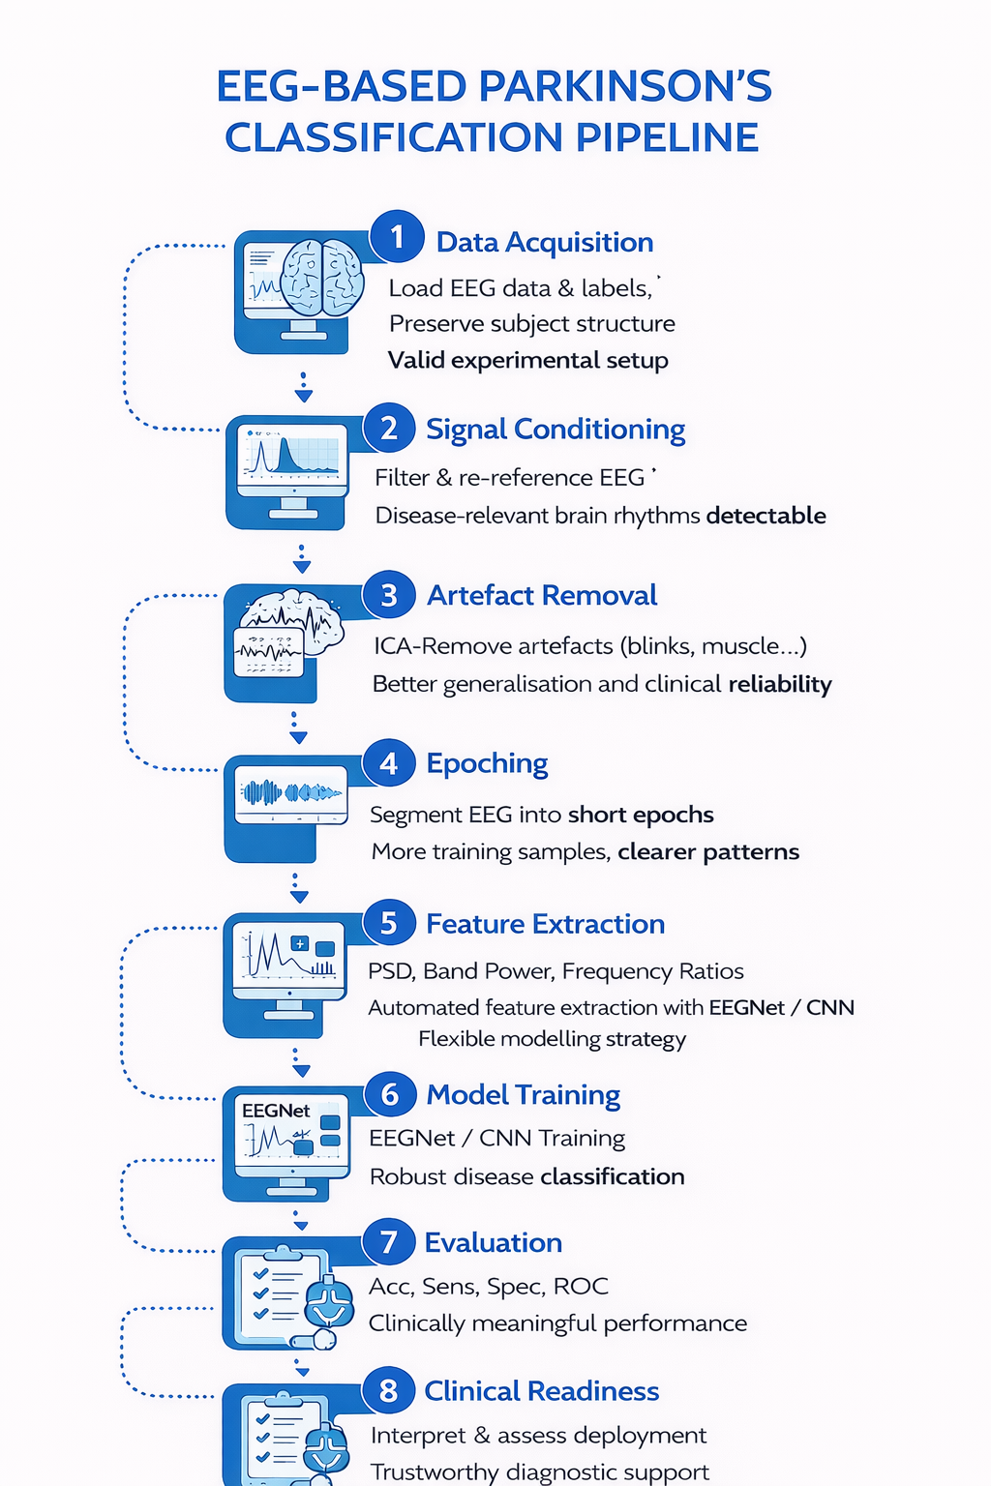
Pipeline
Research-driven pipeline designed by integrating established EEG preprocessing, feature extraction, and deep learning methods from recent Parkinson’s disease studies
Enables robust and generalisable classification by isolating disease-related neural patterns while reducing noise, artefacts, and subject-specific bias
Supports clinically meaningful outcomes, providing a scalable foundation for reliable EEG-based Parkinson’s diagnostic support

Slide 4
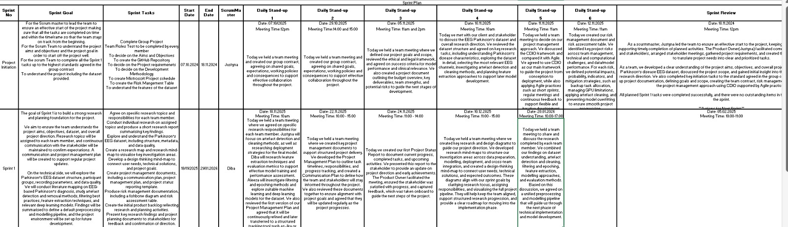
Sprint Plan

Slide 5
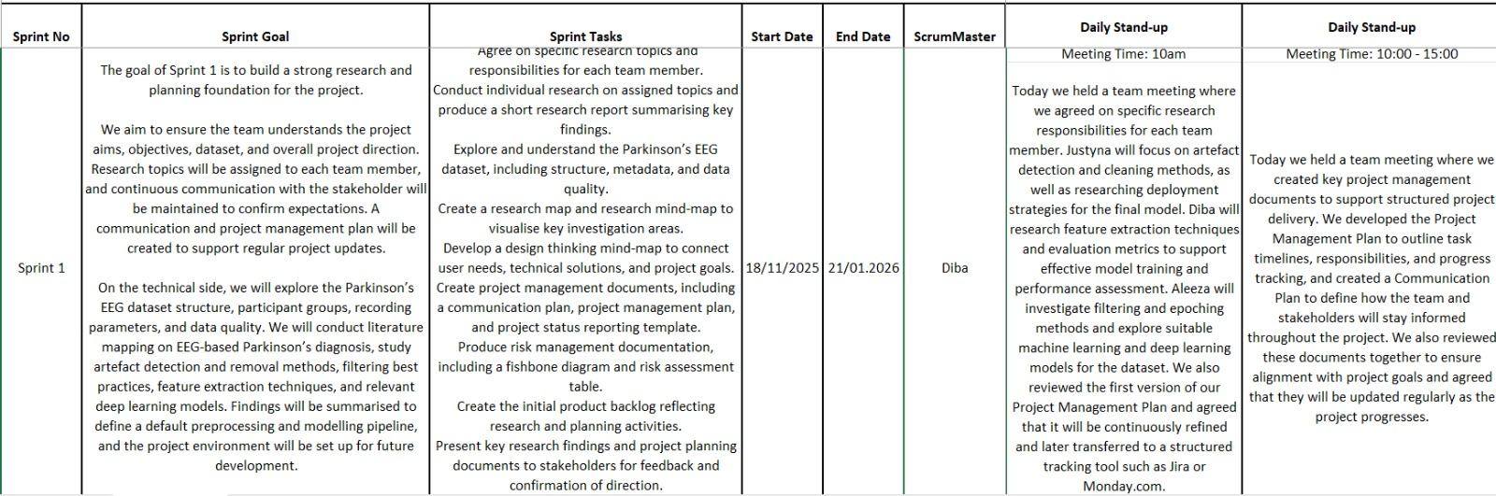

Slide 6
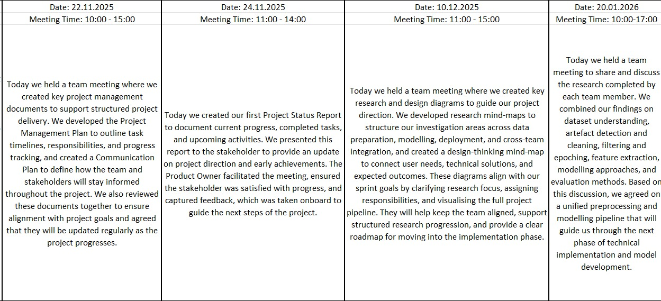

Slide 7
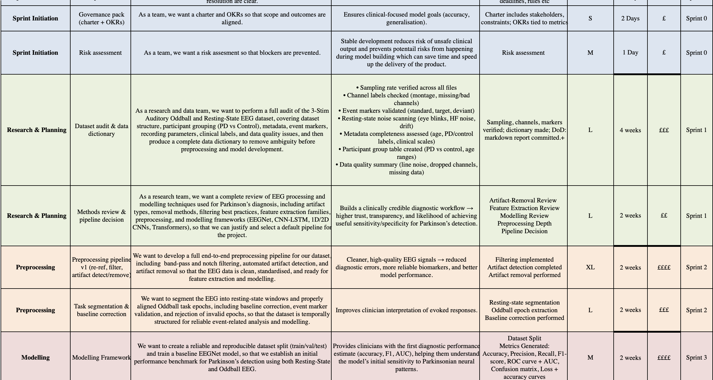
PRODUCT BACKLOG

Slide 8
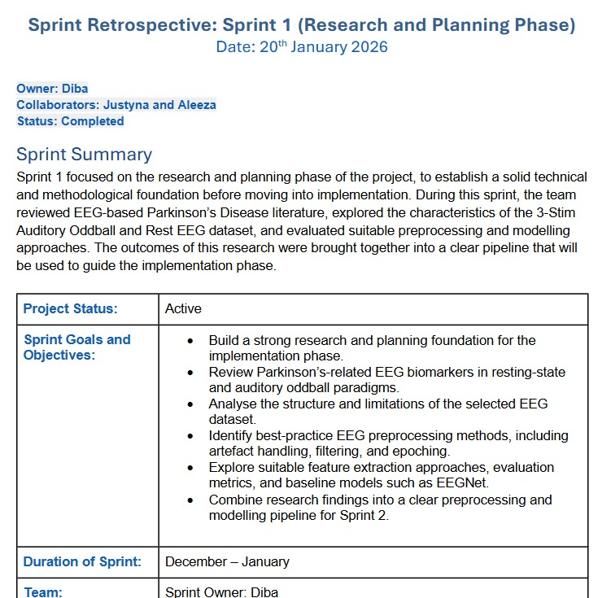
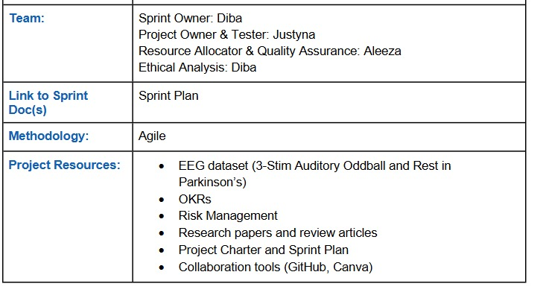
Sprint Retrospective

Slide 9
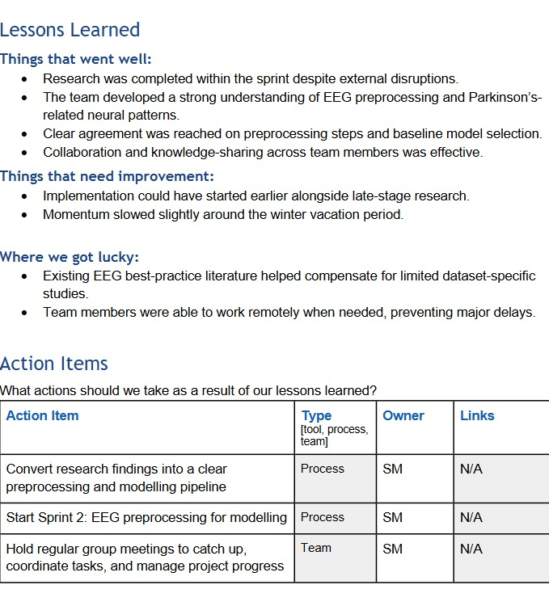
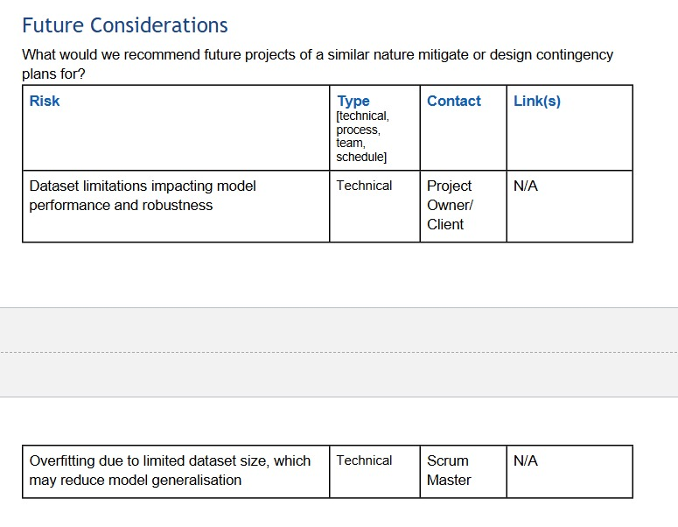

Slide 10
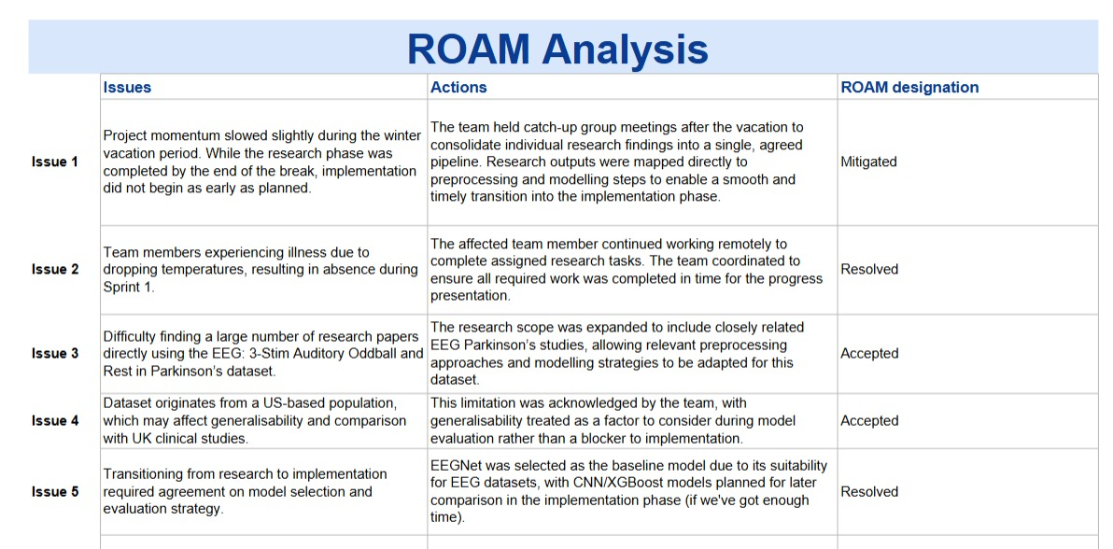
R O A M A N A L Y S I S

